Slide 1
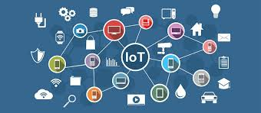
IoT Protocols and communication modes
Lecture-2
Dr. Naushin Nower
Professor, IIT DU

Slide 2
Contents
IoT protocols
Communication Modes
IoT level

Slide 3
IoT Protocol
IoT communication is based on a layered architecture that efficiently organizes data exchange across different protocols.
Data exchange between devices goes through several layers from storage, to processing and to the user interface.
Each layer is responsible for a specific task and communicates with the layers below and above it.

Slide 4
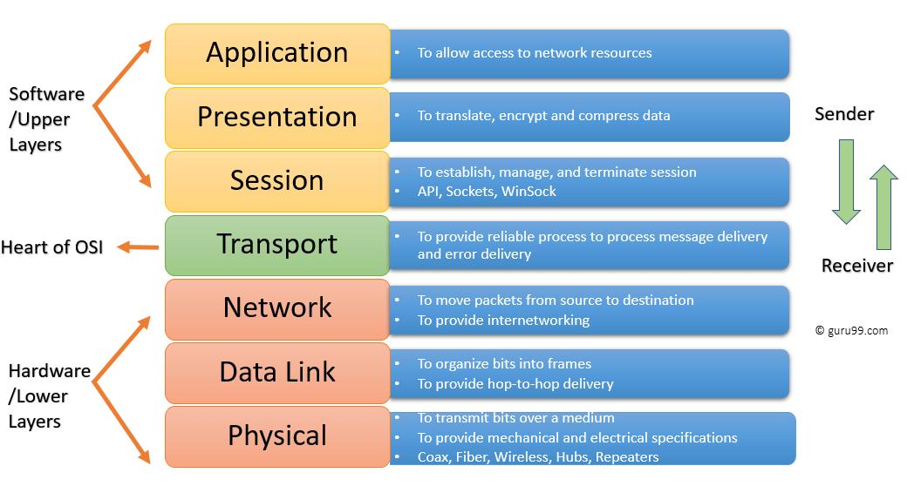
OSI layer

Slide 5
OSI layer..
Mr. Cooper wants to send Ms. Palmer an email. Mr. Cooper composes his message in an email application on his laptop and then hits ‘send’. His email application will pass his email message over to the application layer, which will pick a protocol (SMTP) and pass the data along to the presentation layer.
The presentation layer will then compress the data and then it will hit the session layer, which will initialize the communication session.
The data will then hit the sender’s transportation layer where it will be segmented, then those segments will be broken up into packets at the network layer, which will be broken down even further into frames at the data link layer.
The data link layer will then deliver those frames to the physical layer, which will convert the data into a bits tream of 1s and 0s and send it through a physical medium, such as a cable.

Slide 6
OSI layer..
Once Ms. Palmer’s computer receives the bit stream through a physical medium (such as her wifi), the data will flow through the same series of layers on her device, but in the opposite order.
First the physical layer will convert the bits tream from 1s and 0s into frames that get passed to the data link layer. The data link layer will then reassemble the frames into packets for the network layer. The network layer will then make segments out of the packets for the transport layer, which will reassemble the segments into one piece of data.
The data will then flow into the receiver's session layer, which will pass the data along to the presentation layer and then end the communication session. The presentation layer will then remove the compression and pass the raw data up to the application layer. The application layer will then feed the human-readable data along to Ms. Palmer’s email software, which will allow her to read Mr. Cooper’s email on her laptop screen.

Slide 7
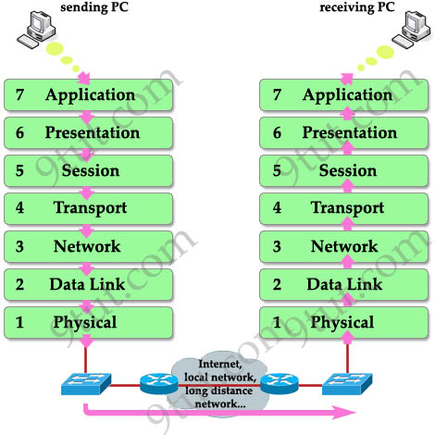
OSI layer..

Slide 8
IoT protocols layers
Physical layer: this layer includes the physical equipment involved in the data transfer, such as the cables and switches.
it converts into a bit stream, which is a string of 1s and 0s. The lowest layer physically connects devices and transmits the bits via cable or mobile communications.
Wi-Fi Bluetooth ZigBee LTE LoRaWAN
Data link layer: the data link layer facilitates data transfer between two devices on the same network.
The data link layer takes packets from the network layer and breaks them into smaller pieces called frames.
responsible for flow control and error control in intra-network communication
Ethernet, PPP (Point-to-Point Protocol), IEEE 802.15.4

Slide 9
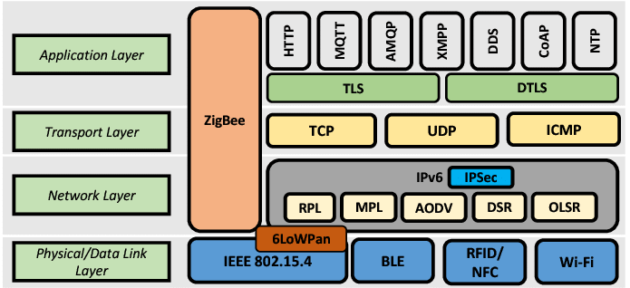
IoT protocol layers

Slide 10
IoT protocols layers..
Network layer
The network layer is responsible for facilitating data transfer between two different networks.
The network layer breaks up segments from the transport layer into smaller units, called packets, on the sender’s device, and reassembling these packets on the receiving device.
The network layer also finds the best physical path for the data to reach its destination; this is known as routing.
IP, RPL, 6LowPAN

Slide 11
IoT protocols layers..
Transport layer: This layer controls the transmission of data between end-to-end communication between the two devices ensuring reliable and orderly transmissions of data packets. TCP, UDP
The application layer provides network services directly to end-user applications. It defines protocols for specific data exchange and communication needs. HTTP, CoAP, MQTT, AMQP etc
https://www.cloudflare.com/learning/ddos/glossary/open-systems-interconnection-model-osi/

Slide 12
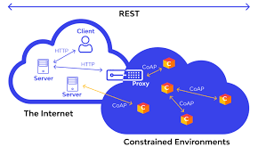
Communication Models in IoT
Request & Response Model
Publisher-Subscriber Model
Push-Pull Model
Exclusive Pair

Slide 13
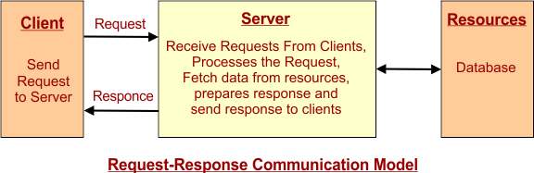
Request & Response Mode
In IoT, the client device sends a request to the server.
The request may be an upload or transfer of data. The Server responds to the request.
The server may be remote or local and can handle the requests of multiple clients.
The server receives the request, processes (decides) the response to that request, and fetches the data from resources (i.e., database).

Slide 14
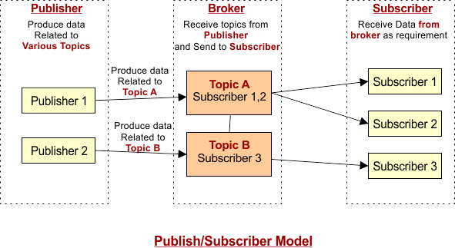
Publisher-Subscriber Model
Publisher: It transfers data to the broker. Publishers don’t know about consumers.
Broker: It accepts publisher data and sends it to the appropriate subscriber.
Subscriber: It consumes the topics that the broker manages.
https://cstaleem.com/iot-communication-models

Slide 15
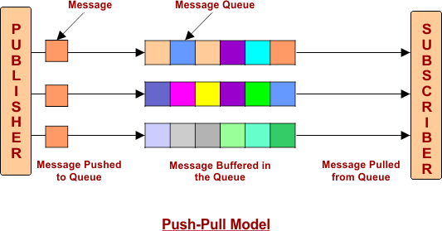
Push-Pull Model
Push-pull involves a direct, often one-to-one, connection between sender and receiver, with either the sender pushing data or the receiver pulling data.
Publisher: It pushes the data into Message Queue
Message Queue: it is a buffer that stores data pushed by a publisher
Subscriber: It pulls data from the message queue.

Slide 16
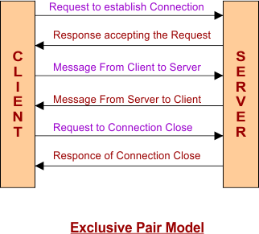
Exclusive Pair
It is a bi-directional.
In an exclusive pair, the client establishes a connection with the server by sending a request, and this connection remains open until the client sends a request to close the connection.

Slide 17
IoT Ecosystem
An IoT ecosystem is a network of interconnected devices, objects, and even people that all work together to collect, share, and act on data. It's like a giant web of things, all communicating with each other to achieve a common goal.
Devices: These are the smart gadgets that we typically associated with IoT, like thermostats, fitness trackers, and even industrial machines.
Sensors: These are the eyes and ears of the devices, picking up things like temperature, motion, or air quality.
Networks: This is how all the devices communicate with each other and send their data to the cloud. It can be through WiFi, cellular networks, or other methods.
Cloud Platforms: This is the big data storage center. The data collected by the devices is sent here to be analyzed and used.
Applications: These programs allow users to interact with the data and control their devices. This could be anything from a phone app to a complex industrial control system.

Slide 18
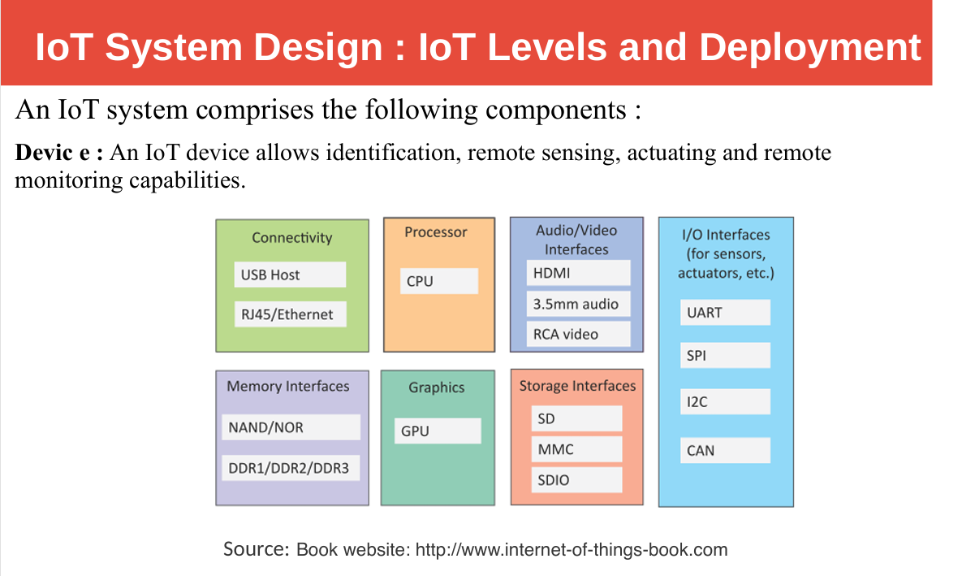

Slide 19
IoT system ..
Resources : Resources are software components on the IoT device for accessing, processing and storing sensor information, or for controlling actuators connected to the device.
Controller Service : Controller service is a native service that runs on the device and interacts with the web services. Controller service sends data from the device to the web service and receives commands from the application (via web services) for controlling the device

Slide 20
IoT system..
Database : Database can be either local or in the cloud and stores the data generated by the IoT device. Web Service : Web services serve as a link between the IoT device, application, database and analysis components.
Web service can be implemented using HTTP and REST principles (REST service) or using the WebSocket protocol (WebSocket service)

Slide 21
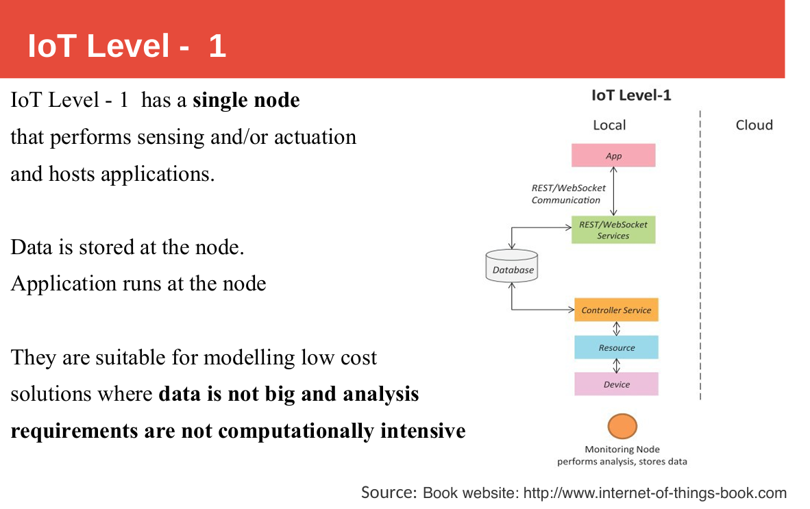

Slide 22
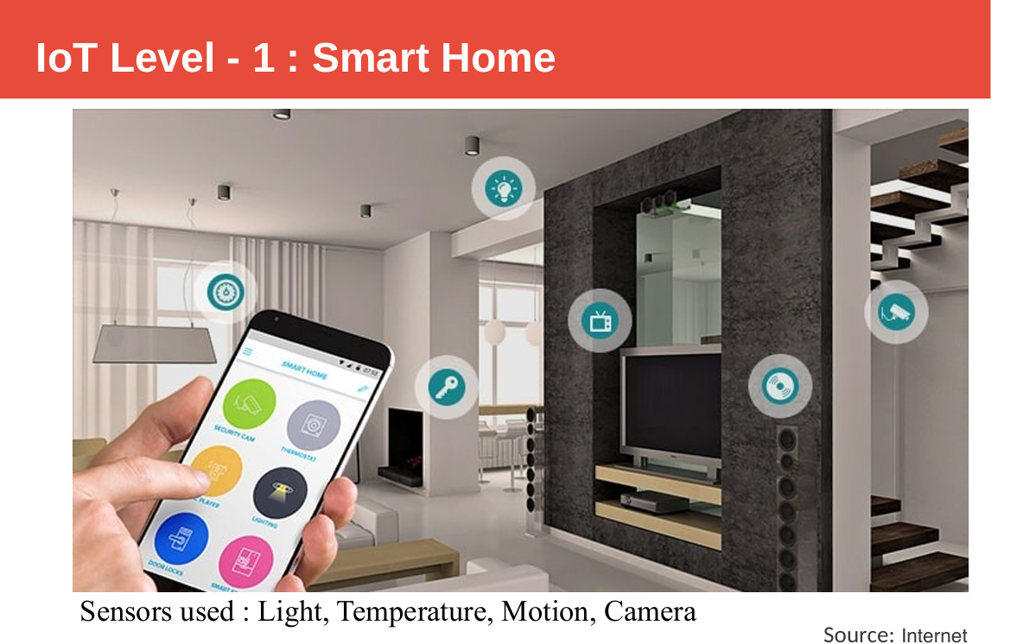

Slide 23
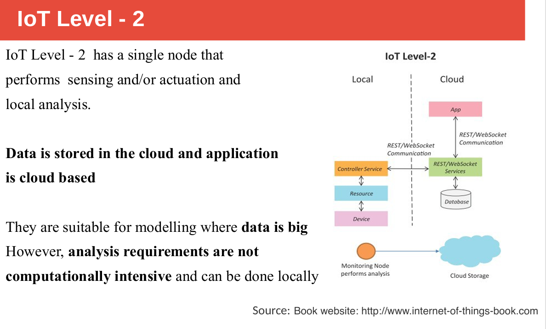

Slide 24
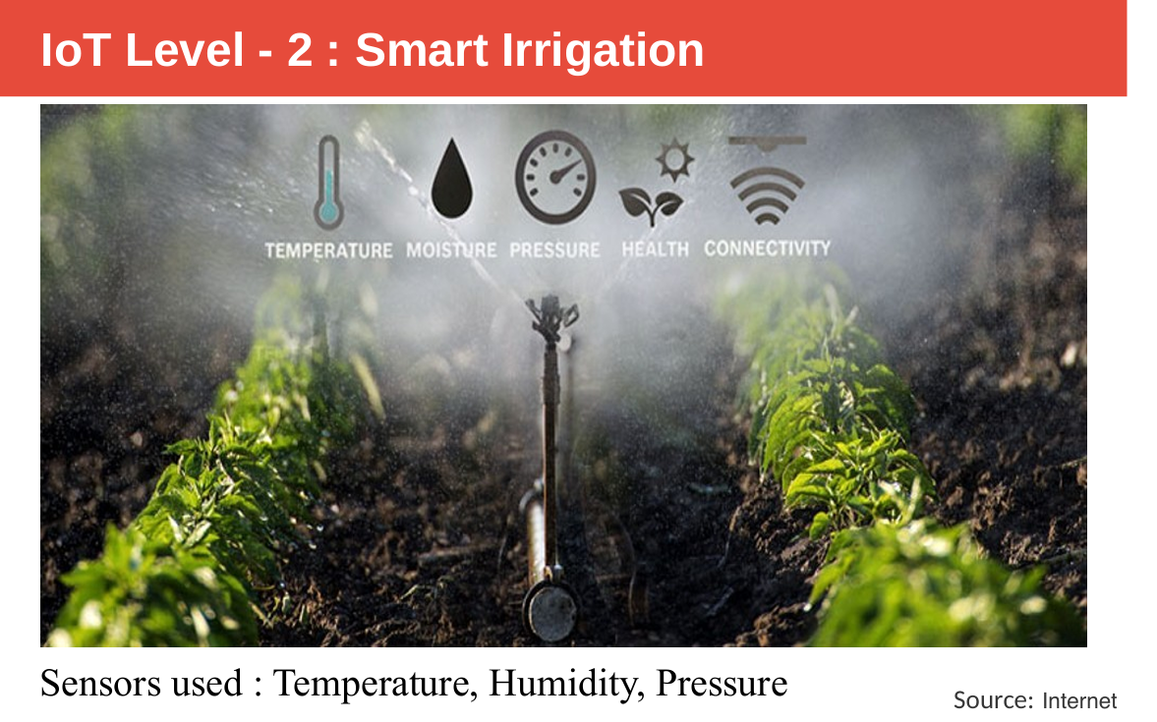

Slide 25
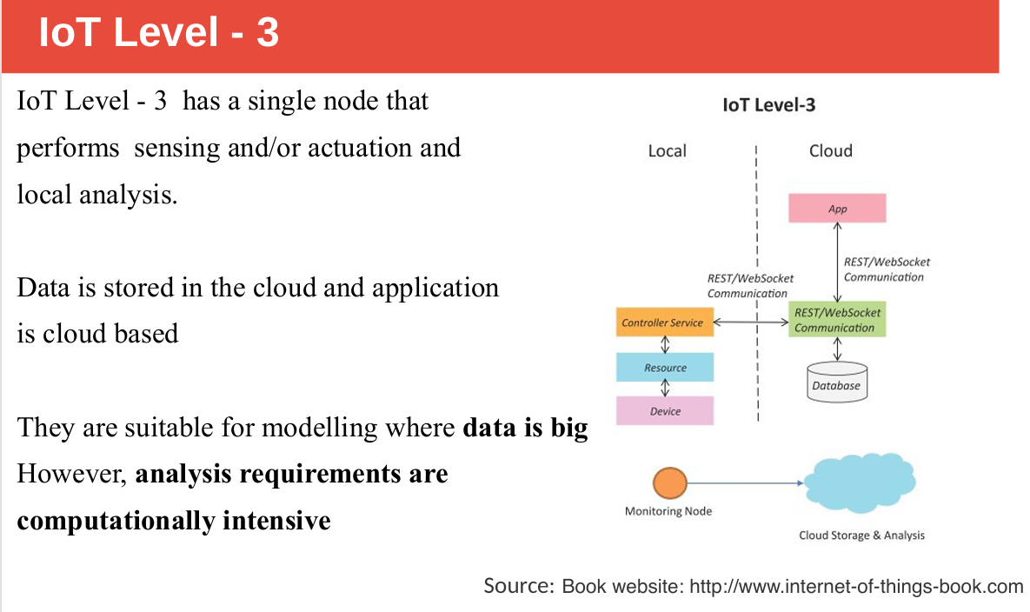

Slide 26
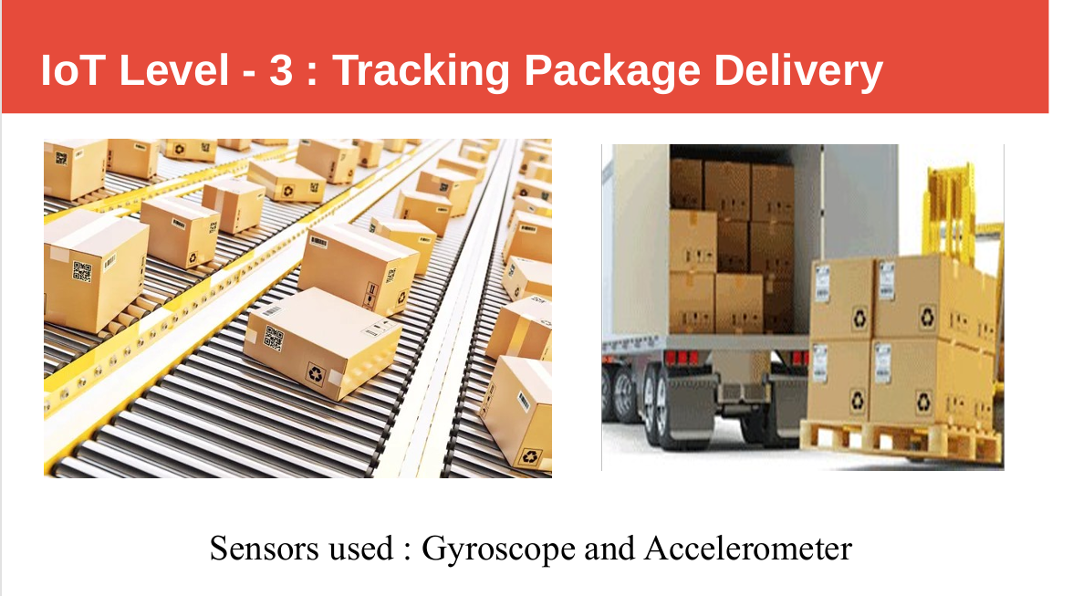

Slide 27
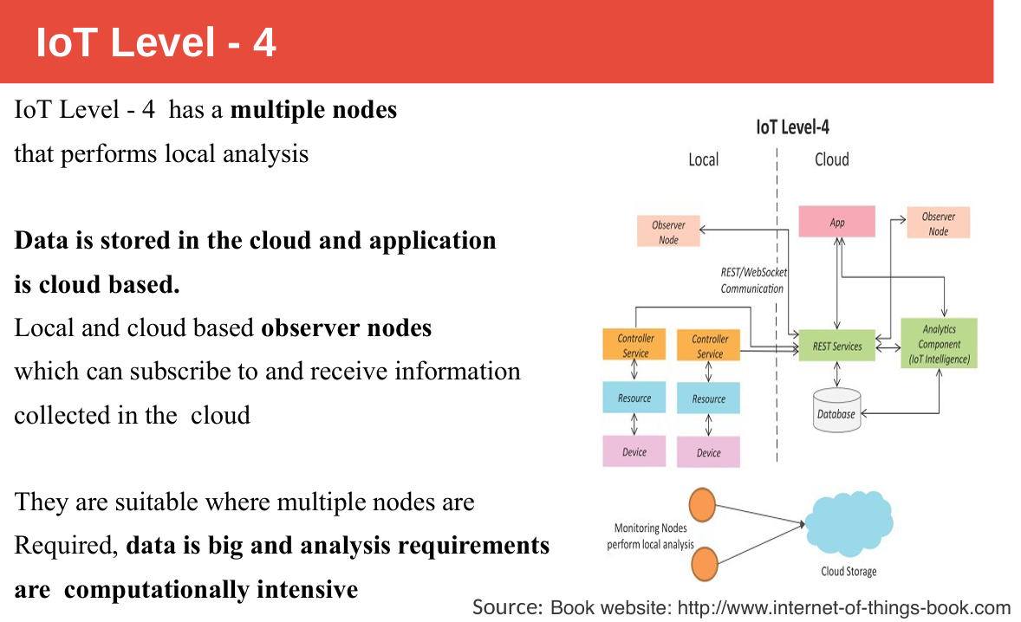

Slide 28
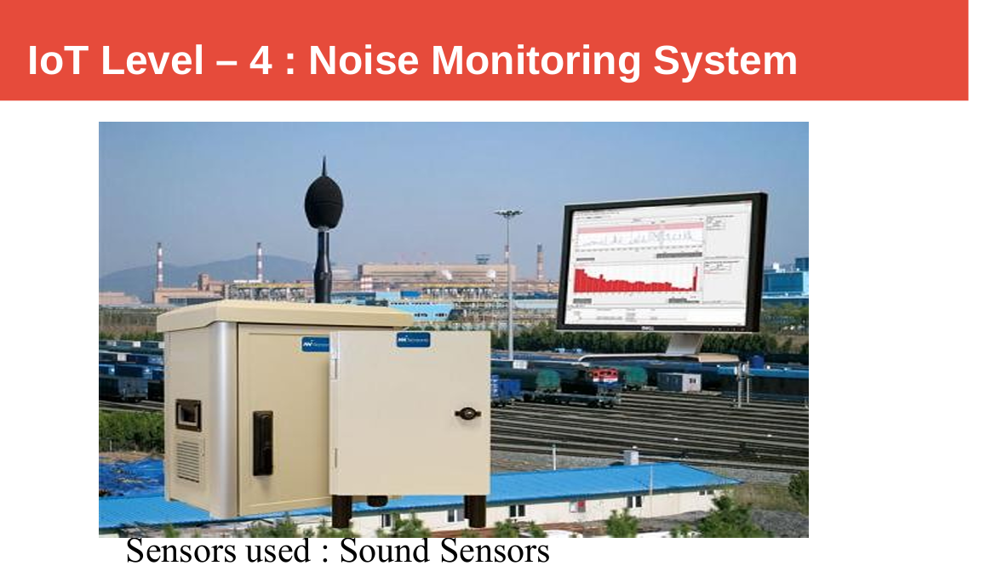

Slide 29
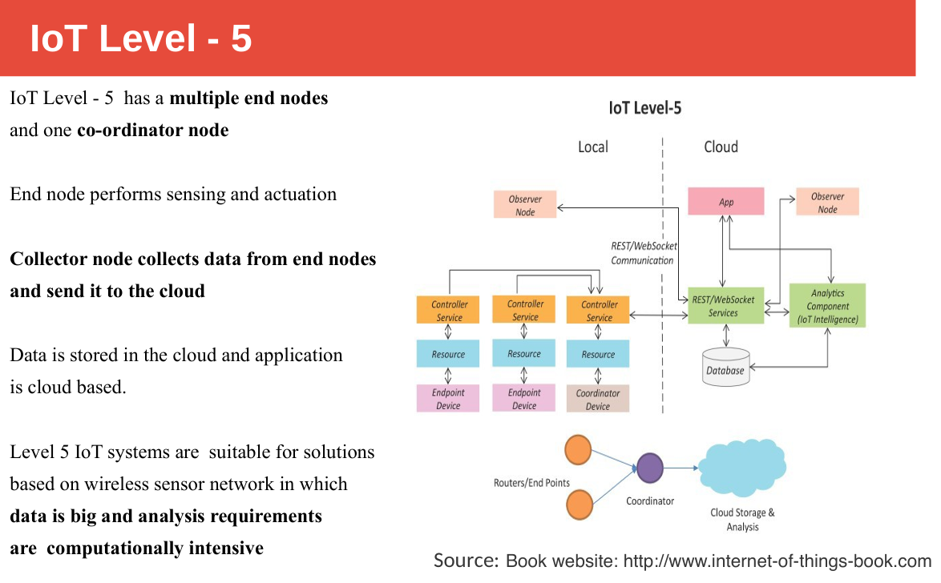

Slide 30
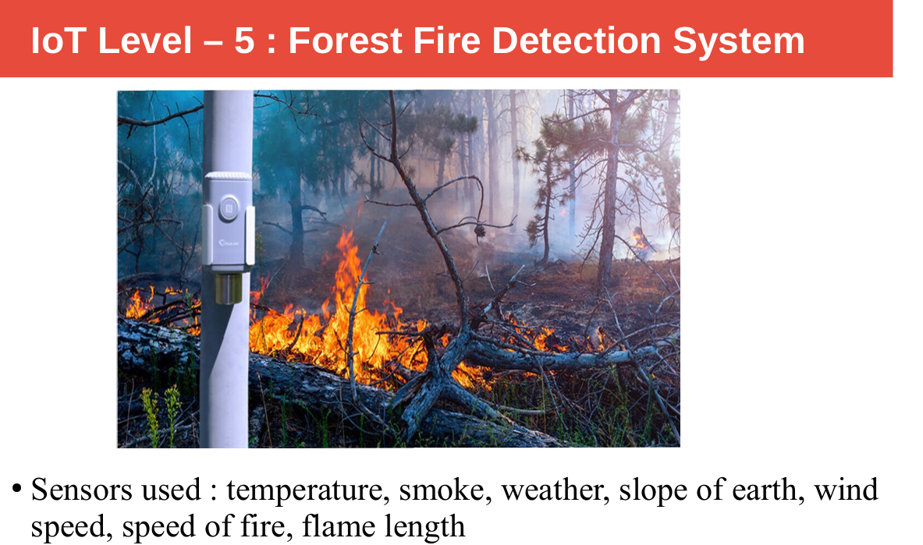

Slide 31
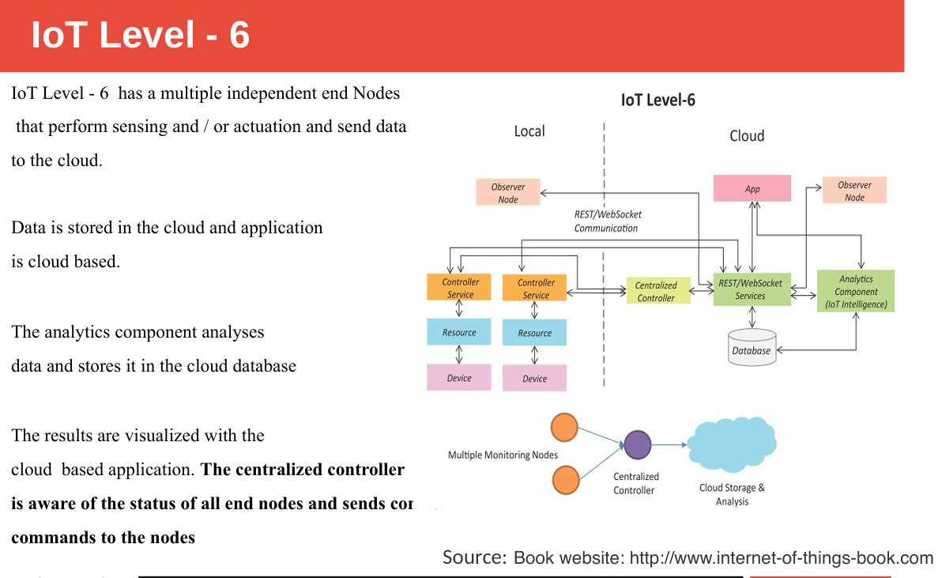
https://technophileholmes.hashnode.dev/internet-of-things-iot-levels

Slide 32
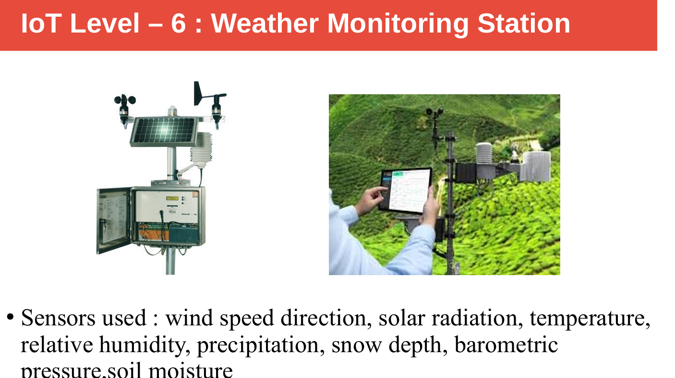

Slide 33
Thank you

